Slide 1

BESTBARNONE.COM
BEST BAR NONE
ACCREDITATION
10 AUGUST 2022

Slide 2
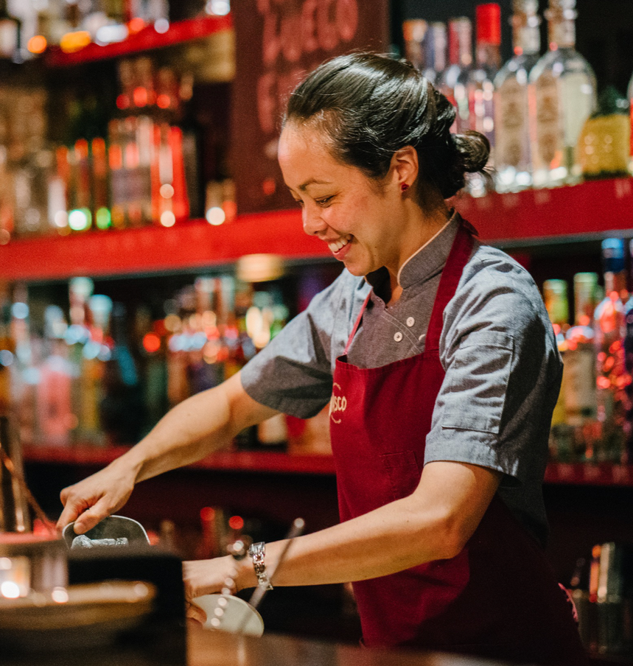
WHAT IS BEST BAR NONE?
  Accreditation for pubs, bars, clubs and other venues serving alcohol
  Supported by the Home Office, alcohol industry and licensed trade
  Demonstrates venues' commitment to customer wellbeing
  Active in 70+ towns & cities in UK

Slide 3
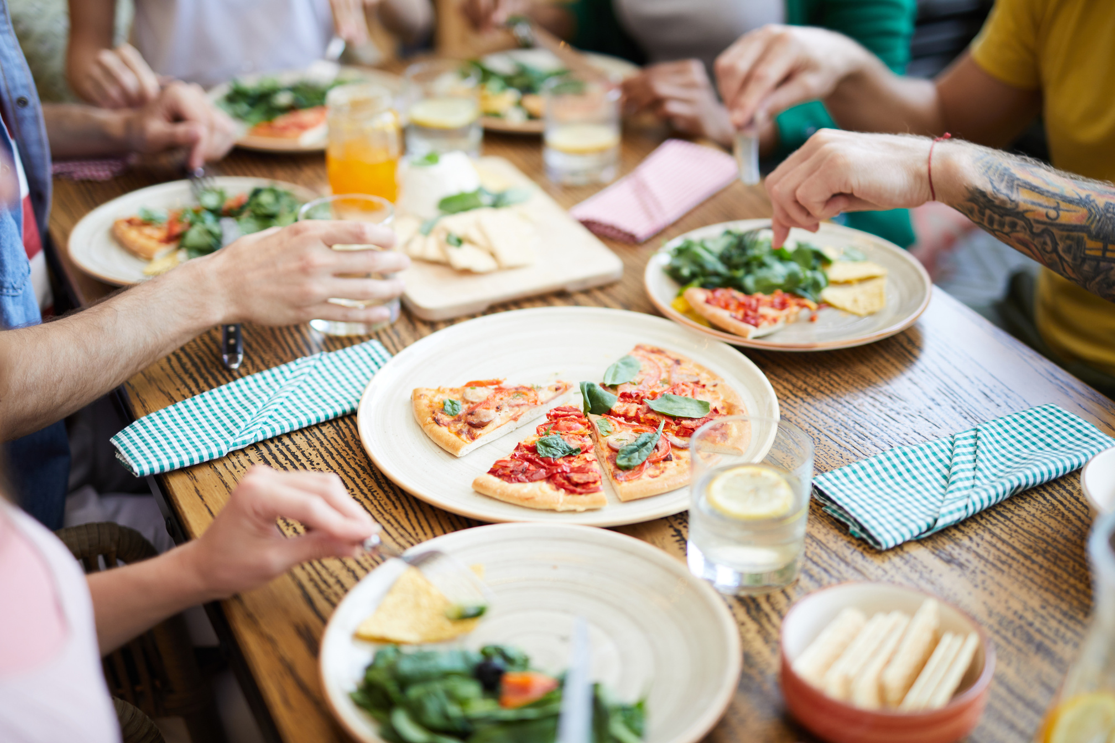

WHAT'S ASSESSED?
1
VENUE MANAGEMENT
Licences, certifications & insurance, safety & security, confiscations & prohibited items, public nuisance, gambling
2
STAFF TRAINING AND CARE
Training provided, safety & wellbeing
3
CUSTOMER SAFETY & WELFARE
Protection of children from harm, responsible drinking, vulnerability management, ingress & egress
4
CUSTOMER EXPERIENCE & COMMUNITY
Community contributions, diversity of offer, assessor's impression

Slide 4

CUSTOMER THOUGHTS...
  More than one in four adults aged 18-45 are more likely to visit a venue with a safety award
  This figure is higher for LGBT (39%), BAME (38%) and women (35%) customers
Source: YouGov survey, 2021

Slide 5

OPPORTUNITIES TO BECOME ACCREDITED
1
REGIONAL SCHEMES
Run locally as a partnership led by council licensing, police licensing or Business Improvement Districts. 70+ schemes currently.
2
NATIONAL SCHEME
Accreditations carried out for single sites or for the whole estate of multi site operators with a new national model
3
OTHER SCHEMES
NUS scheme for universities, plus airports, race courses, casinos, football stadia and other licensed premises

Slide 6
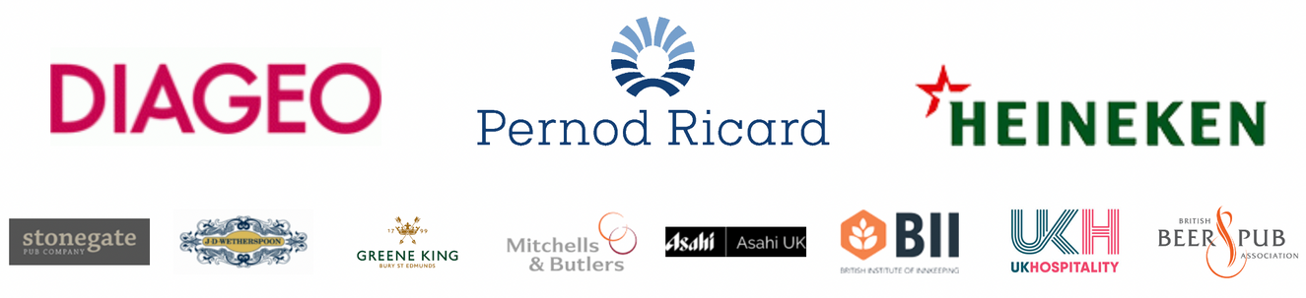
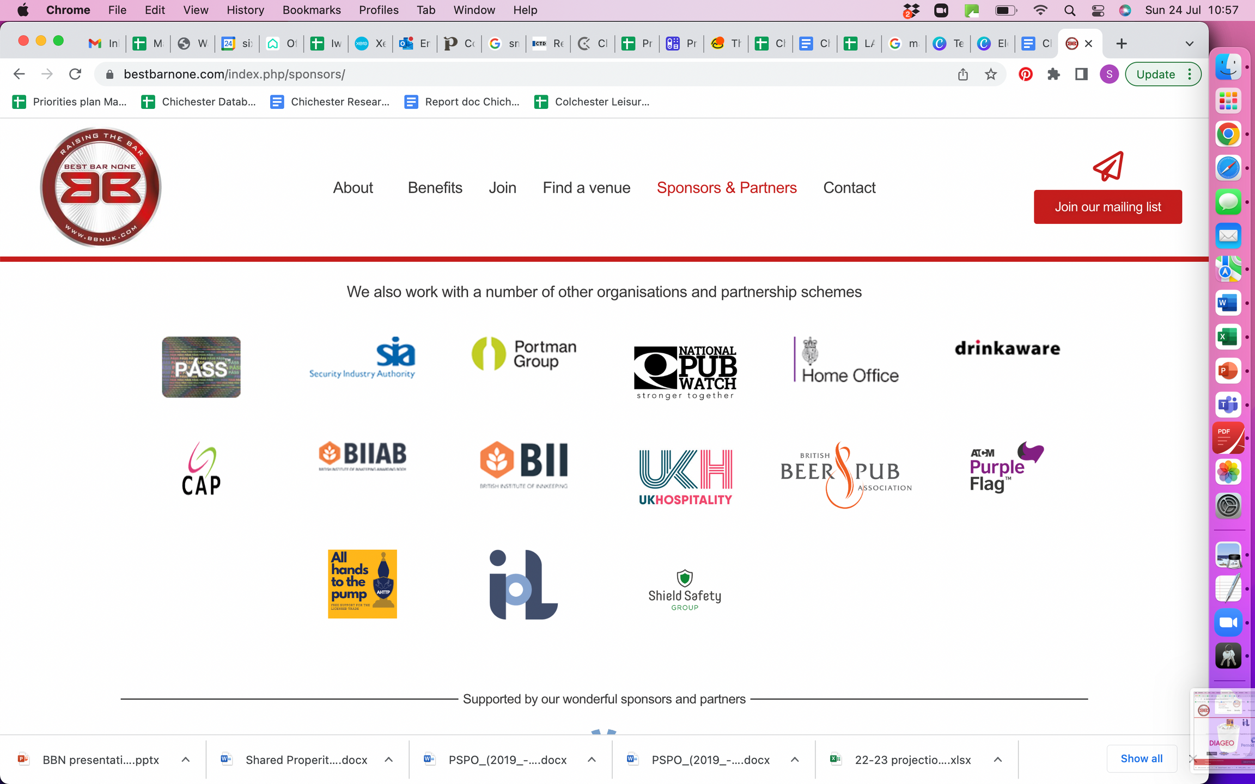
OUR PARTNERS

Slide 7

BENEFITS OF
becoming accredited
For towns and cities
  Well run venues focussed on customer wellbeing
  A safer, more inclusive NTE
  Partnership working, better dialogue
  Continual improvements

Slide 8
BENEFITS OF
becoming accredited
For students and their parents
Peace of mind that the area and its venues are working together to address:
  General safety and vulnerability
  Drink spiking
  Drugs
  Responsible drinking

Slide 9
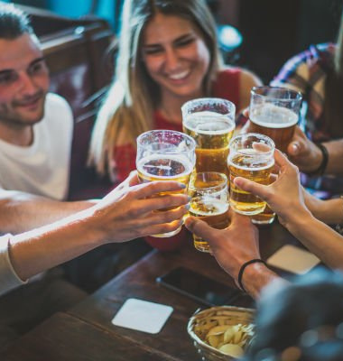
BEST BAR NONE AND ASRA
  Promoting the scheme locally
  Work with local schemes to support their success
  Encourage areas without a scheme to set up
  Other ideas

Slide 10
THANK YOU
Sylvia Oates
    sylvia.oates@bestbarnone.com
National
    info@bestbarnone.com
    0115 936 5033
    www.bestbarnone.com

